Slide 1

Predicting Diabetes
By Allie Wicklund

Slide 2
Table of Contents
Choosing the Model
Accuracy or ***Recall?
Population
The Big Picture
Learning Outcomes

Slide 3
Choosing the Model
Logistic Regression
Best accuracy and ***recall

Slide 4
Choosing the Model
To be used for testing criteria, not diagnostics!

Slide 5
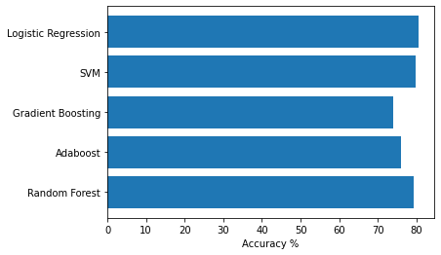
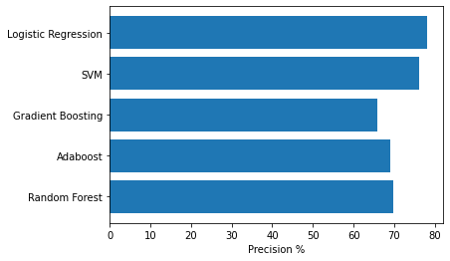
Accuracy vs ***Recall

Slide 6
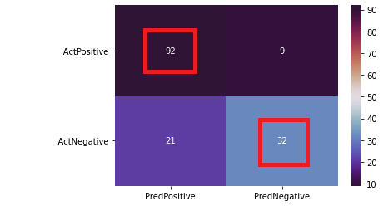
Accuracy
92+32
-----------
92+9+21+32

Slide 7
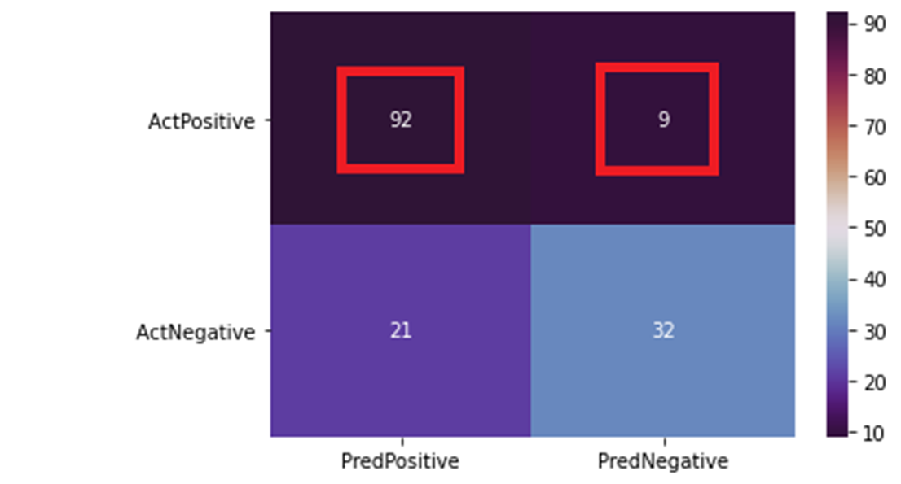
***Recall
92
--------
92+9

Slide 8
Why ***Recall?
Hypoglycemia (low blood sugar)
“If left untreated, hypoglycemia can cause fainting and the person may also lose consciousness. In severe cases, seizures and even death may occur.”

Slide 9
Why ***Recall?
In healthcare, it’s better to test a healthy person than treat a healthy person for a disease they don’t have
i.e: diabetes, cancer, endometriosis, leukemia, etc.

Slide 10
Population
Pima Indian heritage
21+ years old
Female
769 patients

Slide 11
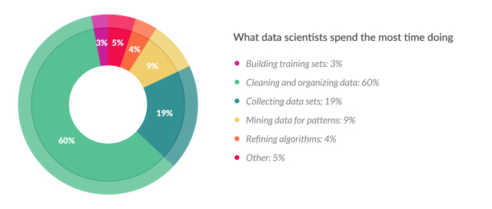
The Big Picture

Slide 12
The Big Picture
60%
3%
1%
3%
33%
What’s other?

Slide 13
Learning Outcomes

Slide 14
Learning Outcomes
More complex models =/= better models

Slide 15
Learning Outcomes
More complex models =/= better models
Garbage in, garbage out

Slide 16
Learning Outcomes
More complex models =/= better models
Garbage in, garbage out
A rough schedule would help

Slide 17
Learning Outcomes
More complex models =/= better models
Garbage in, garbage out
A rough schedule would help
***Always double-check your confusion matrix
***Always double-check your definitions

Slide 18
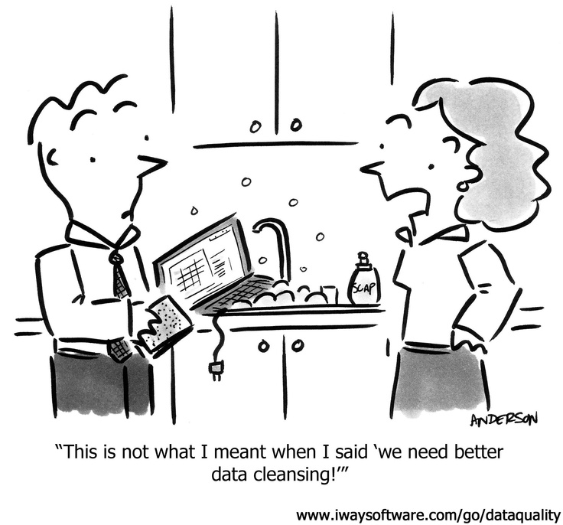
Thank you!

